Slide 1

TRANSFER BUSINESS OF EPL CLUBS
SURAAJ SHRESTHA

Slide 2

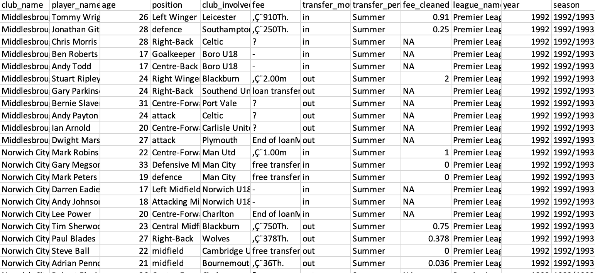
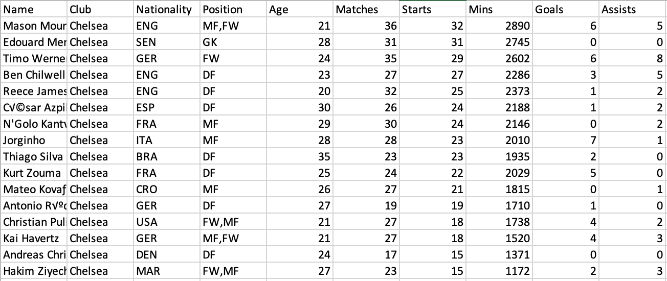
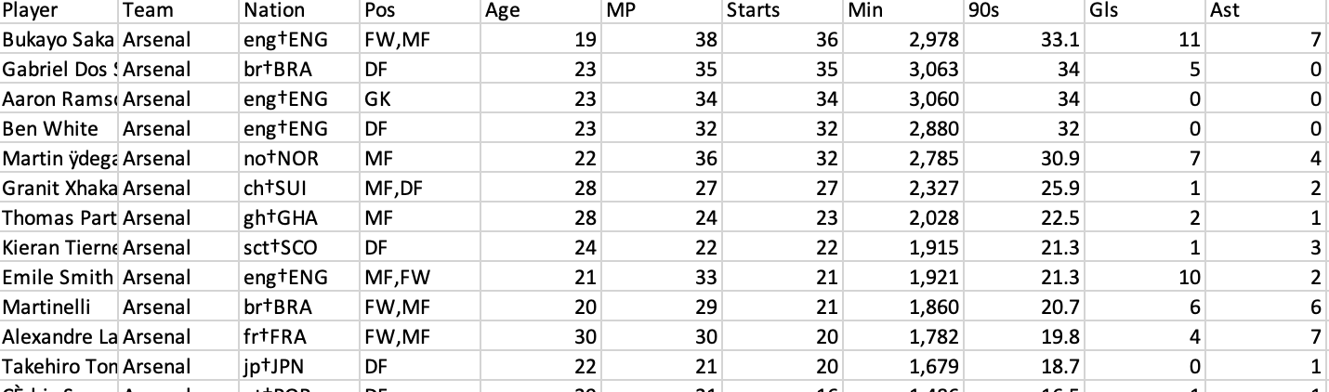
ABOUT DATA
DATASET FROM KAGGLE
TRANSFER LISTINGS FROM SEASON 1992/1993 UNTIL NOW.
PLAYER STATS FROM SEASONS 2020/2021 & 2021/2022.

Slide 3
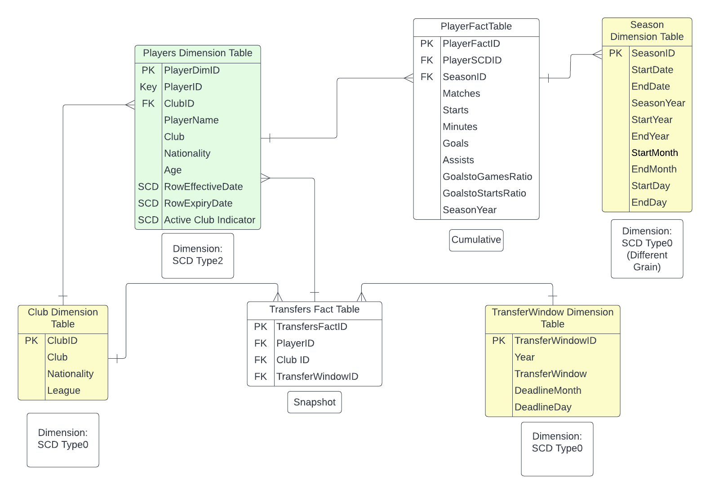
DESIGN

Slide 4
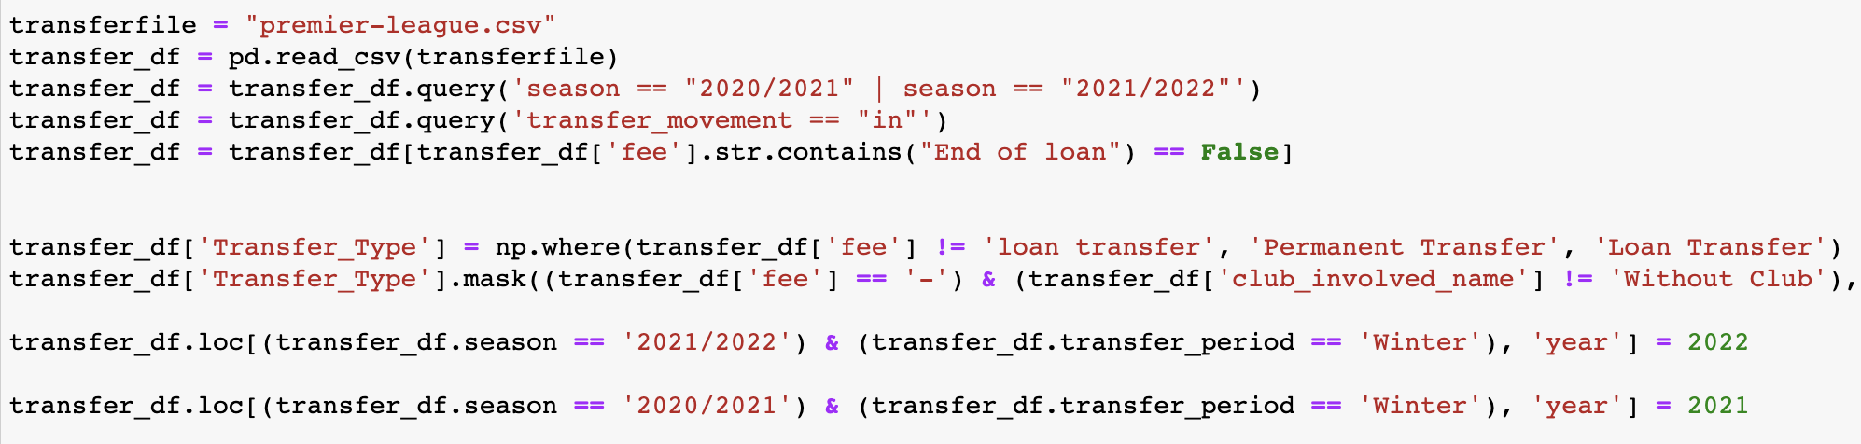
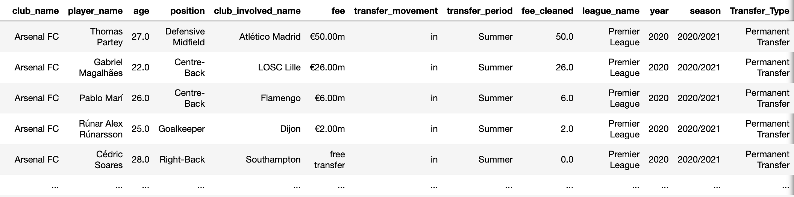
etl
QUERY ONLY THE SEASON 2020/2021 & 2021/2022 AND ONLY THE TRANSFERS INTO THE CLUB
FIGURE OUT DIFFERENT TYPE OF TRANSFERS AND CLEAN THE FEE ACCORDINGLY

Slide 5
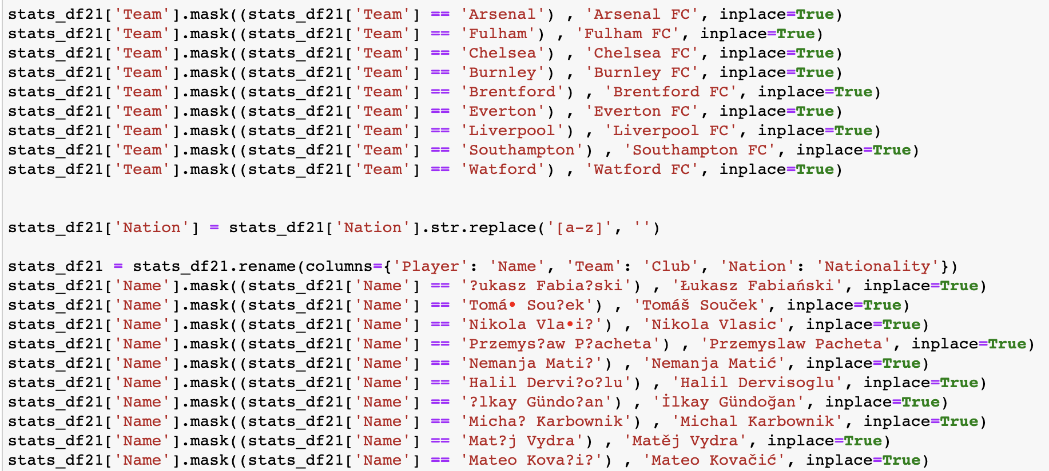
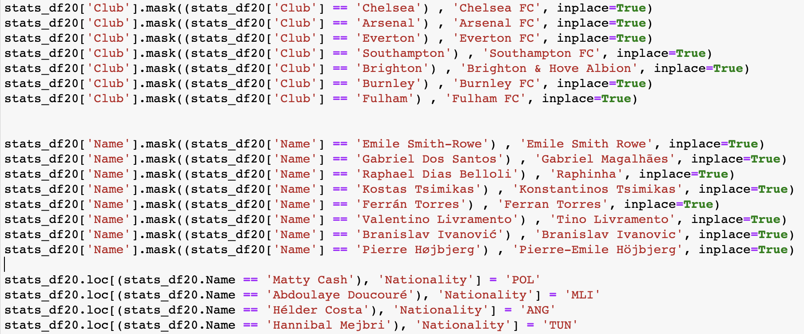
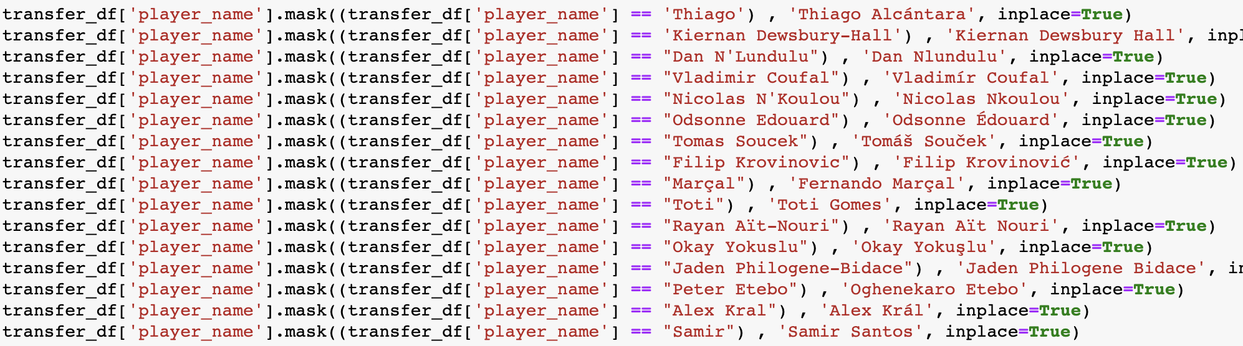
ETL

Slide 6
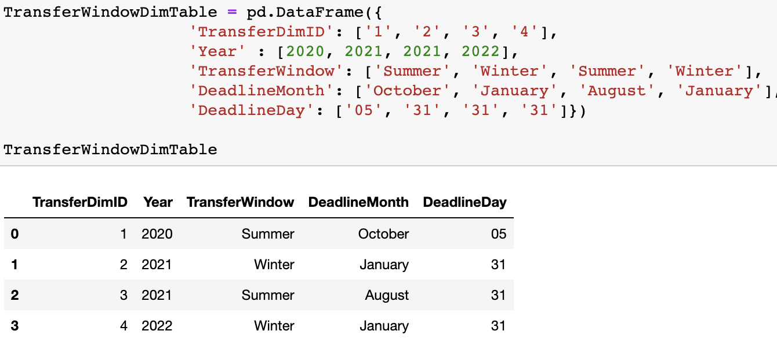
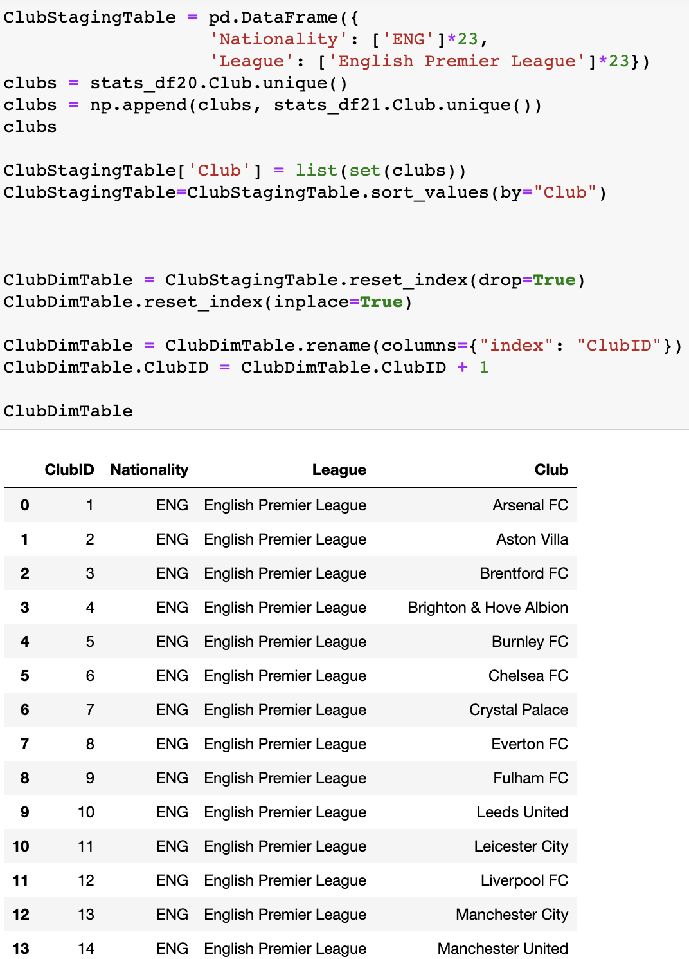
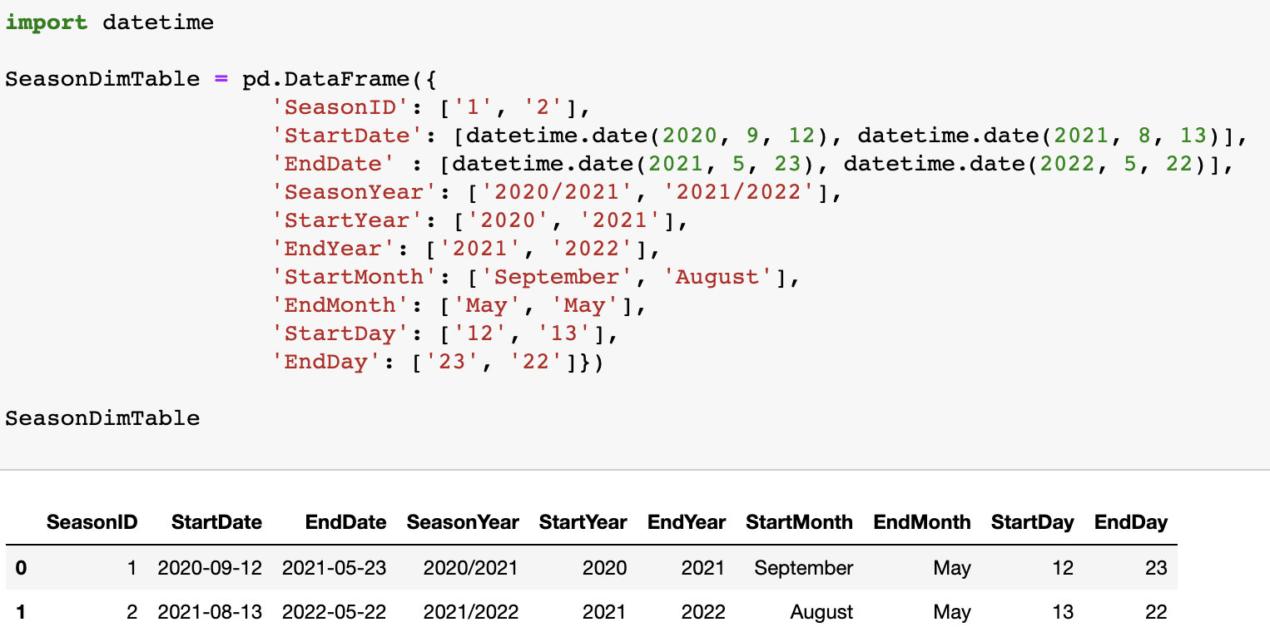
ETL

Slide 7
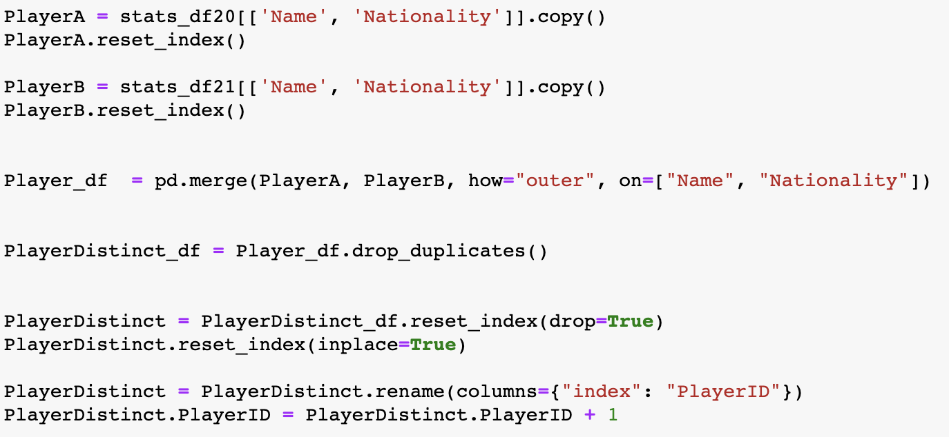
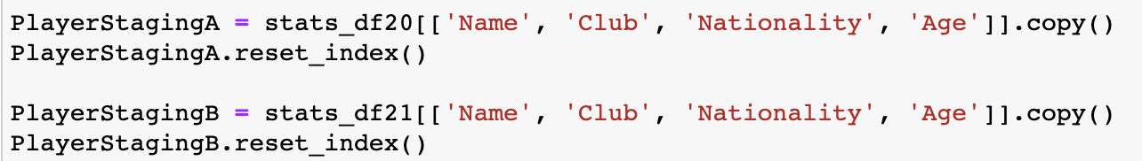
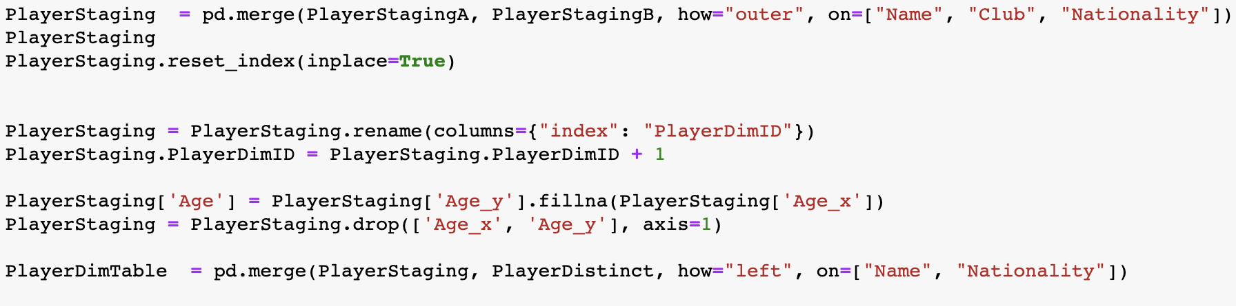
ETL: player dimension table SCD TYPE2

Slide 8
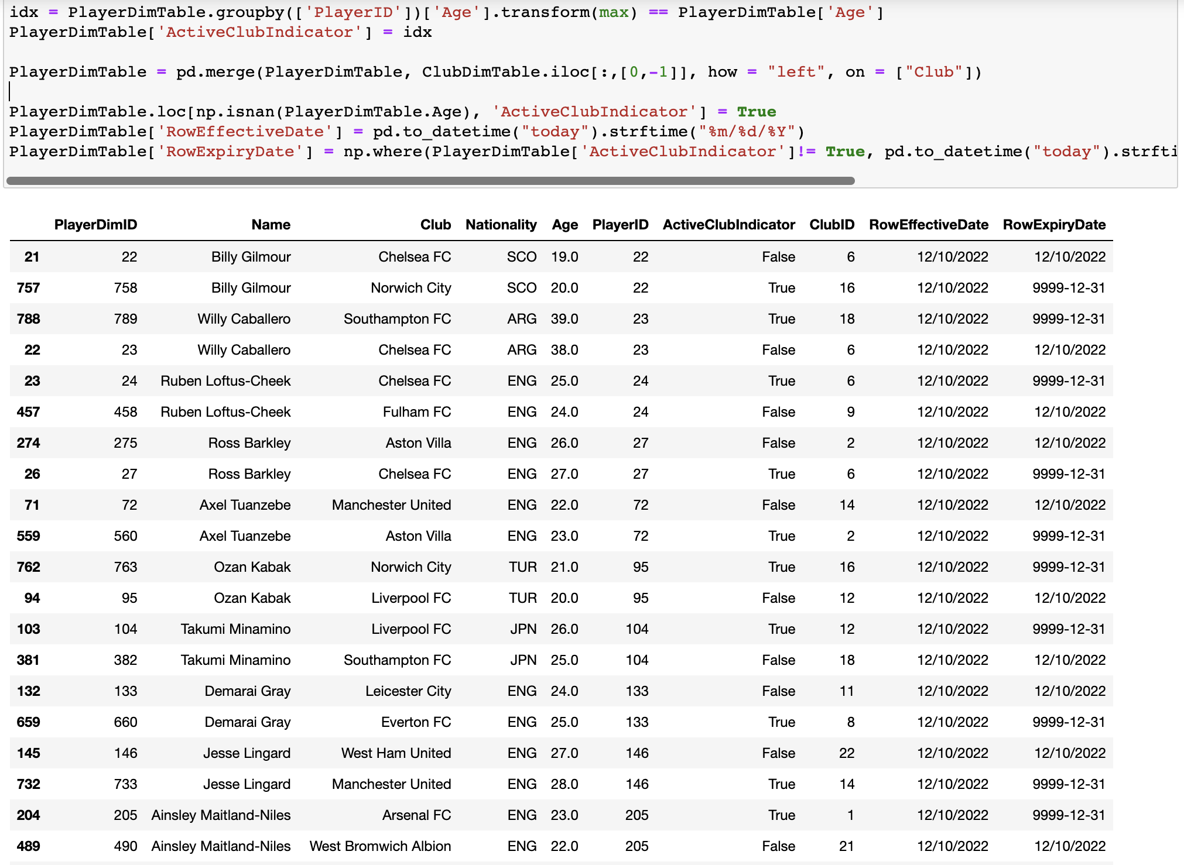
ETL: player dimension table SCD TYPE2

Slide 9
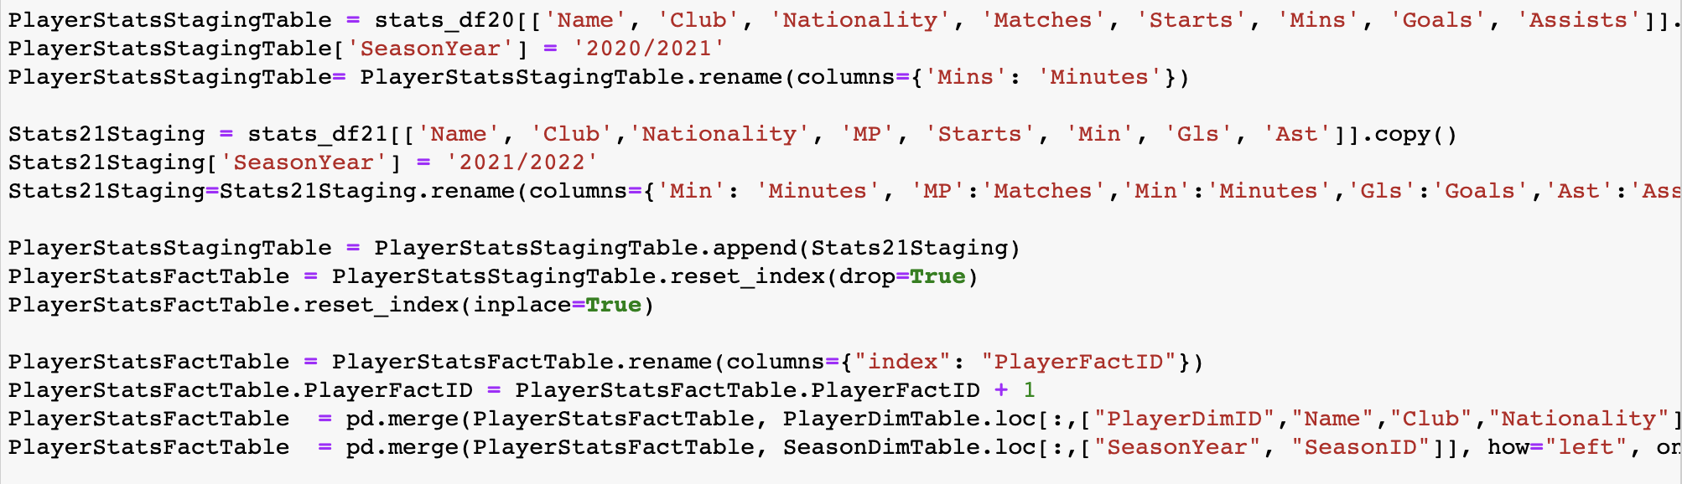
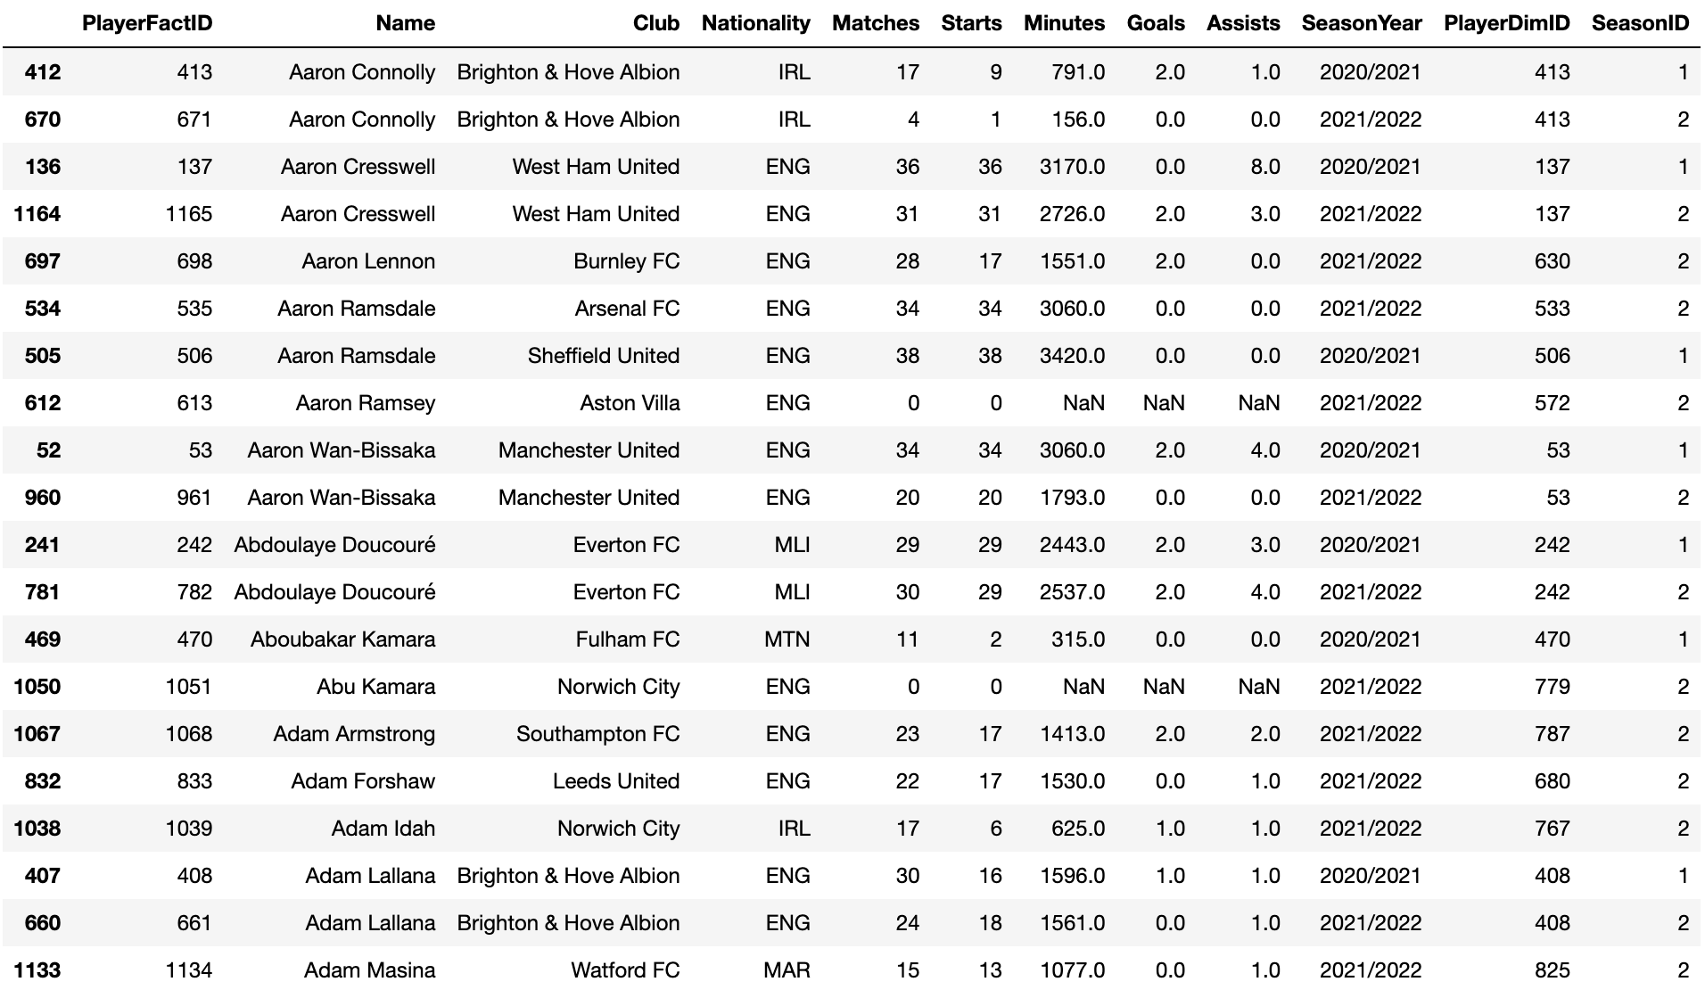
ETL: Player stats fact table

Slide 10
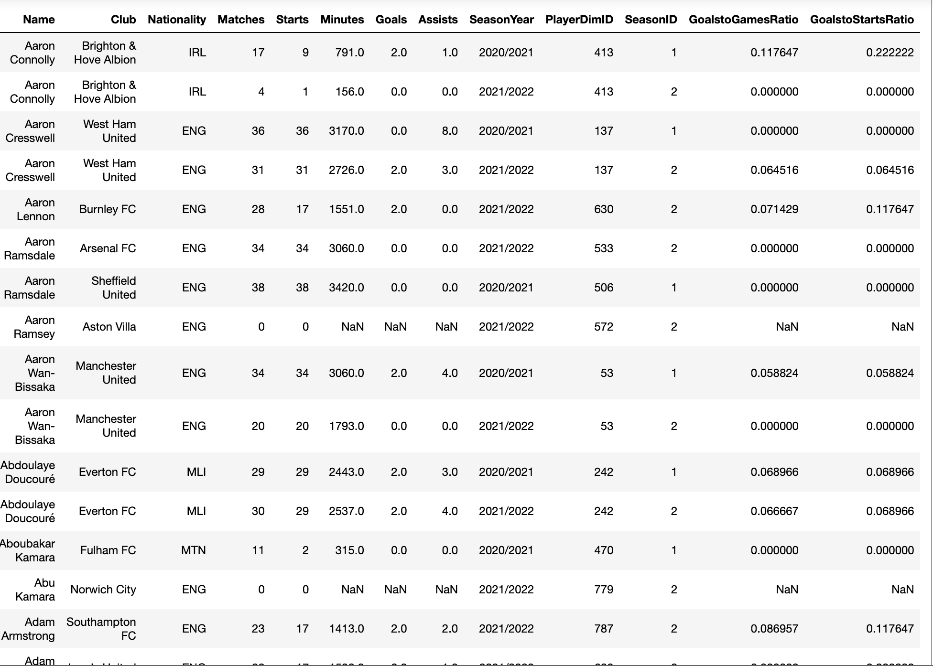
ETL: Player stats fact table Measures

Slide 11
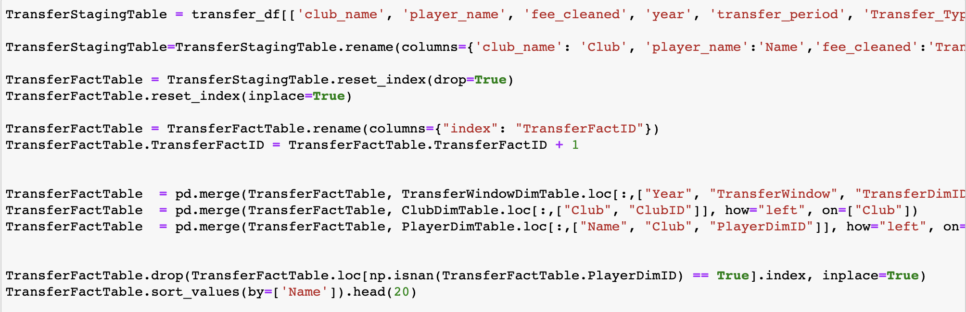
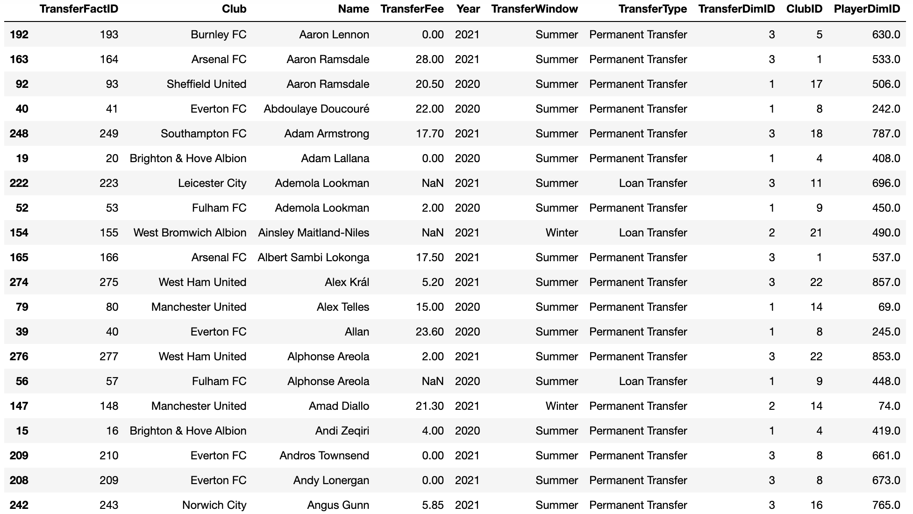
ETL: TRANSFERS fact table

Slide 12
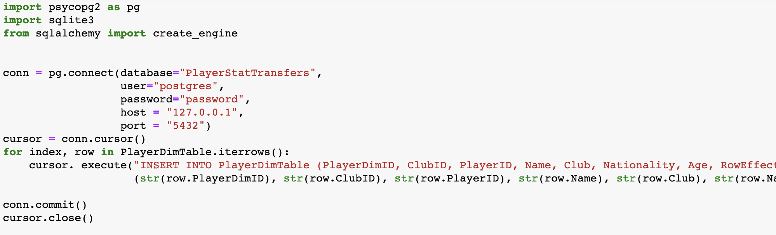
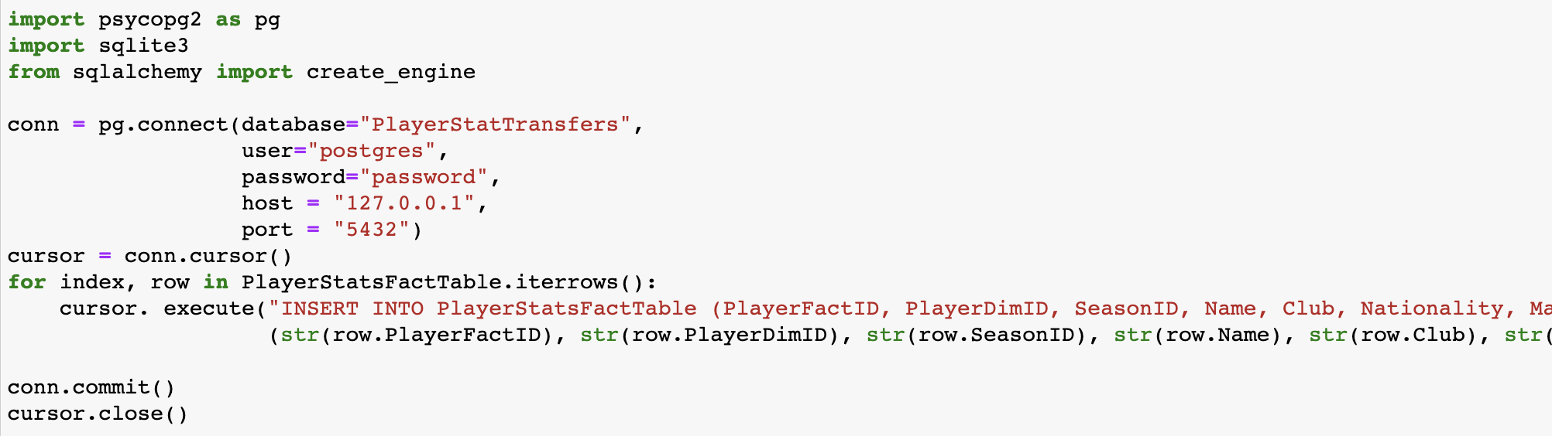
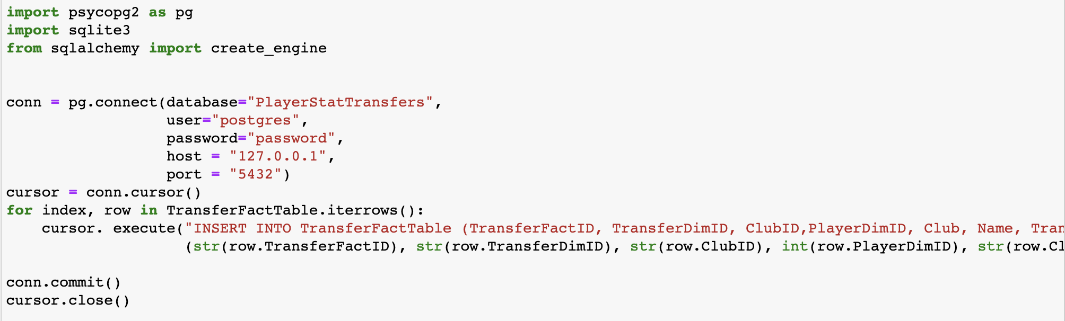
ETL

Slide 13
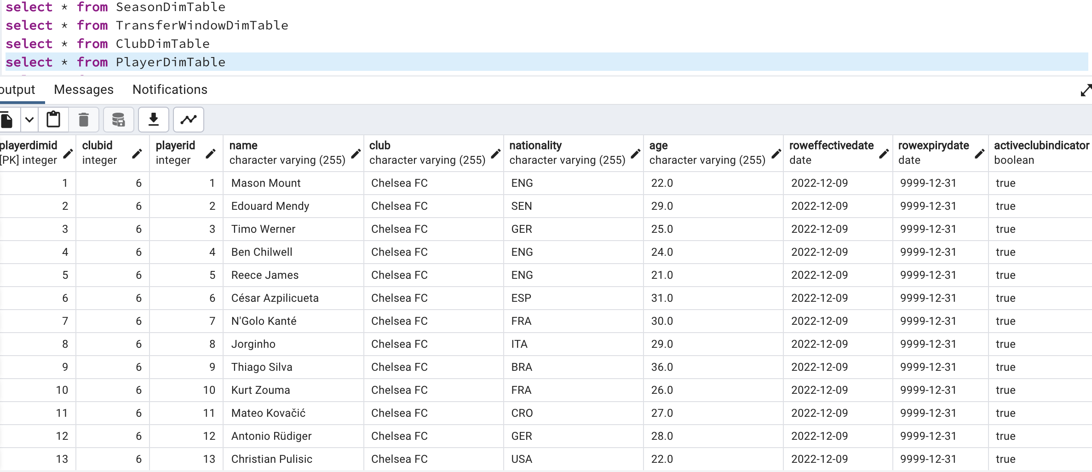
ETL

Slide 14
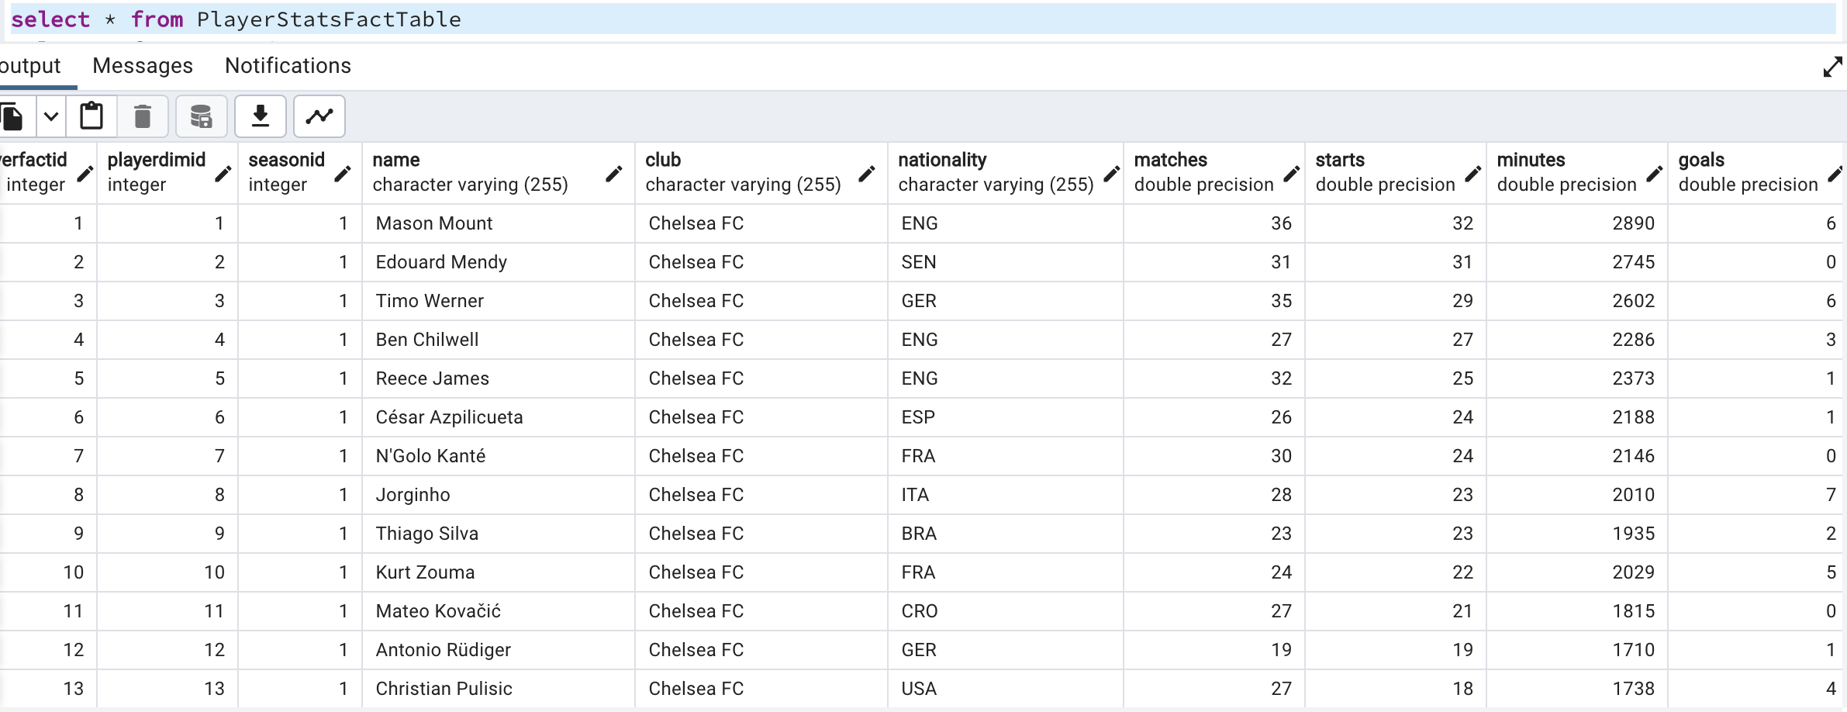
ETL

Slide 15
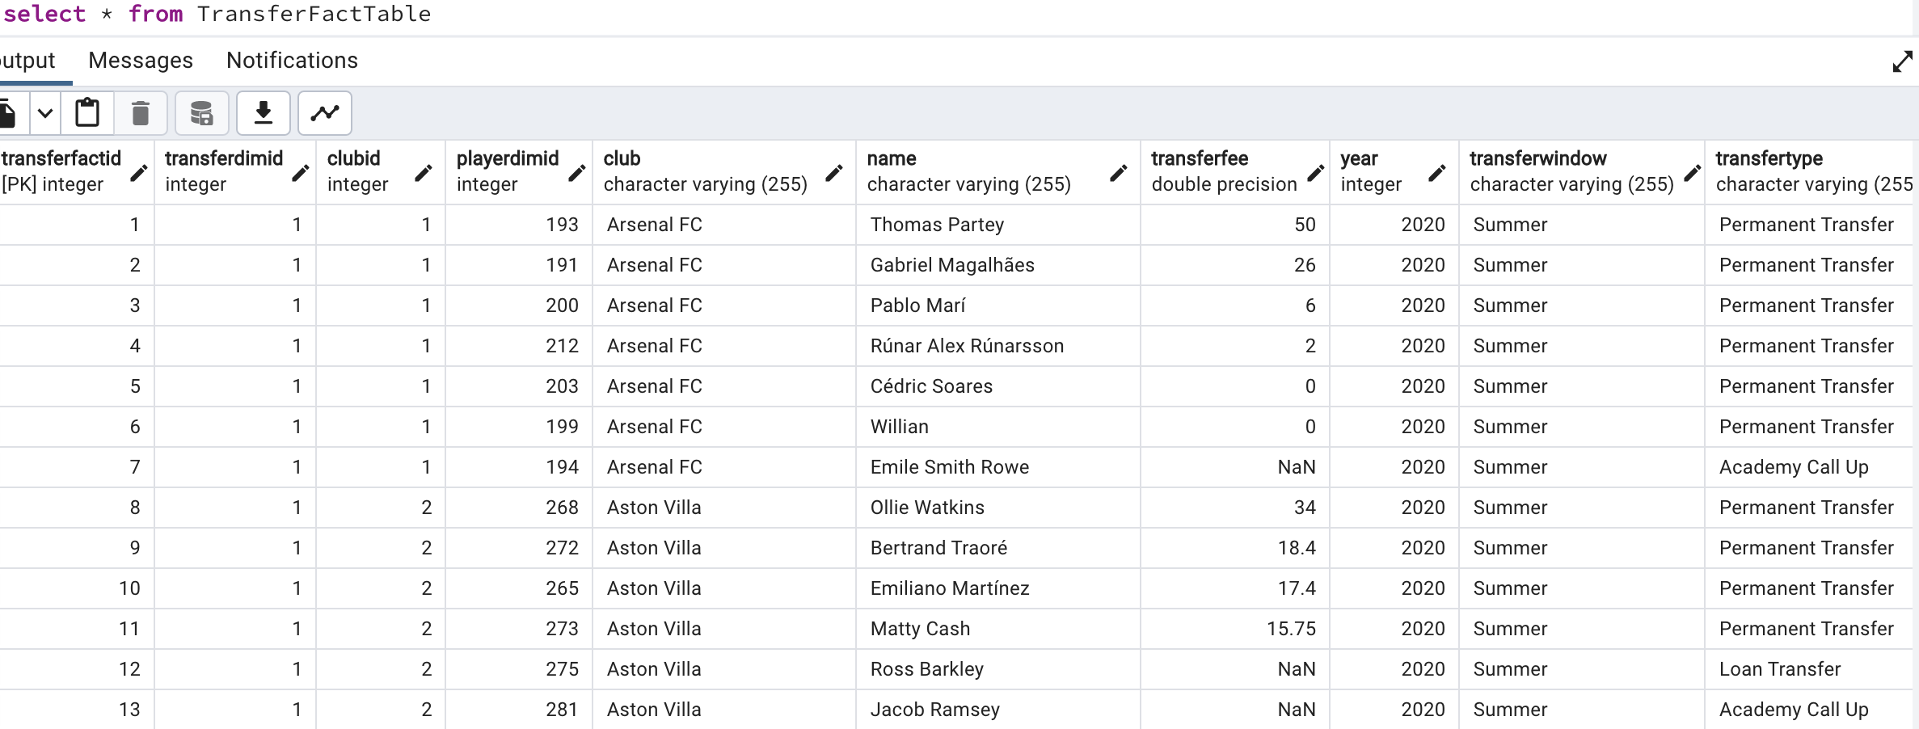
ETL

Slide 16
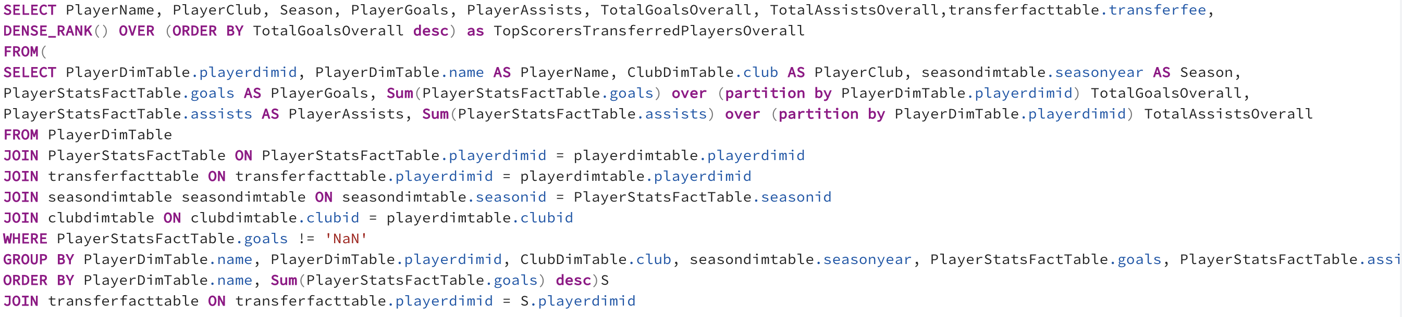
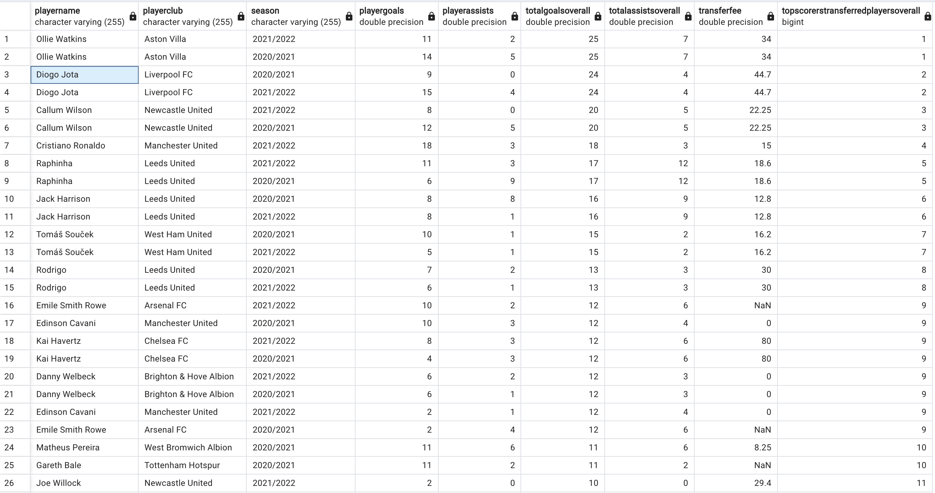
SQL Query

Slide 17
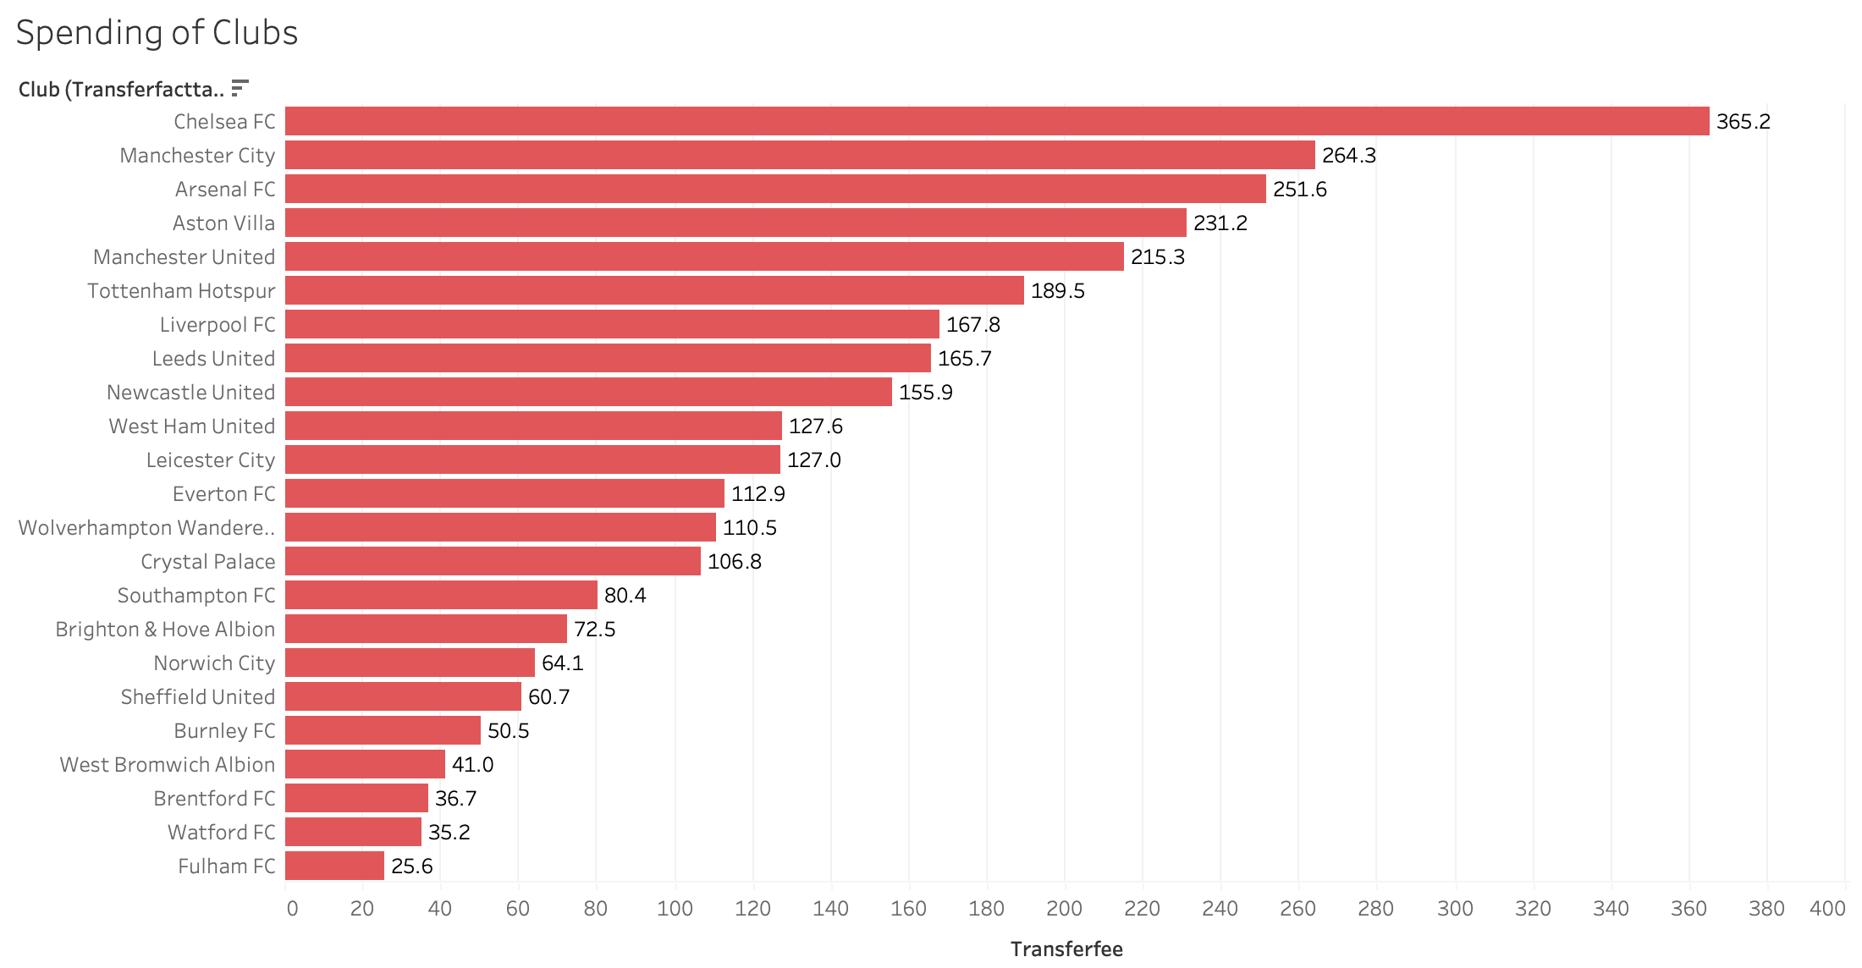
CLUBS SPENDING FOR 2020/2021 & 2021/2022

Slide 18
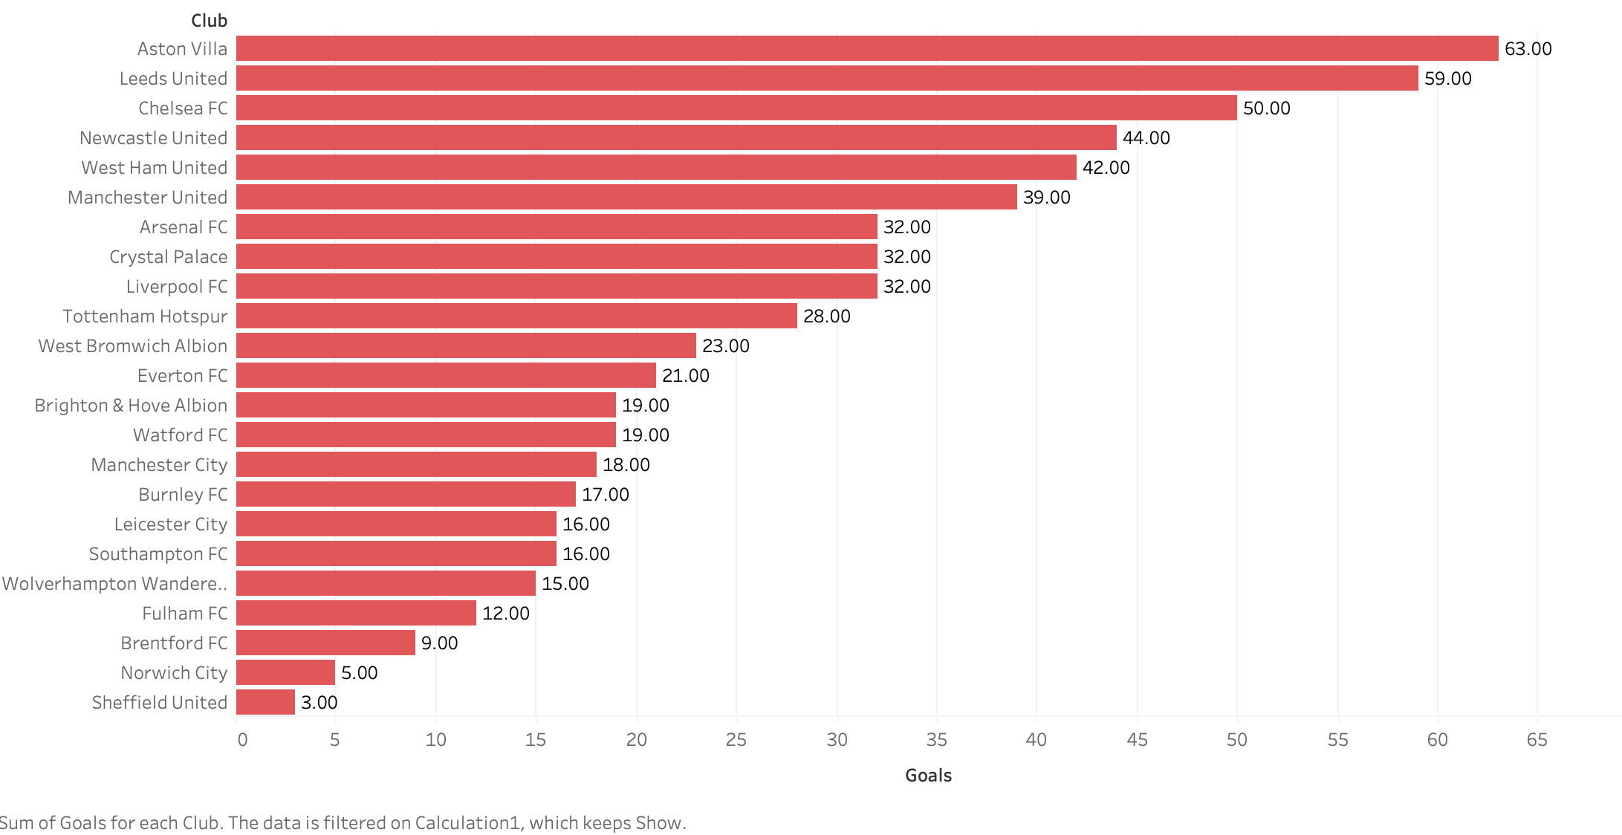
GOALS SCORED BY TRANSFER INS 2020/2021 & 2021/2022

Slide 19
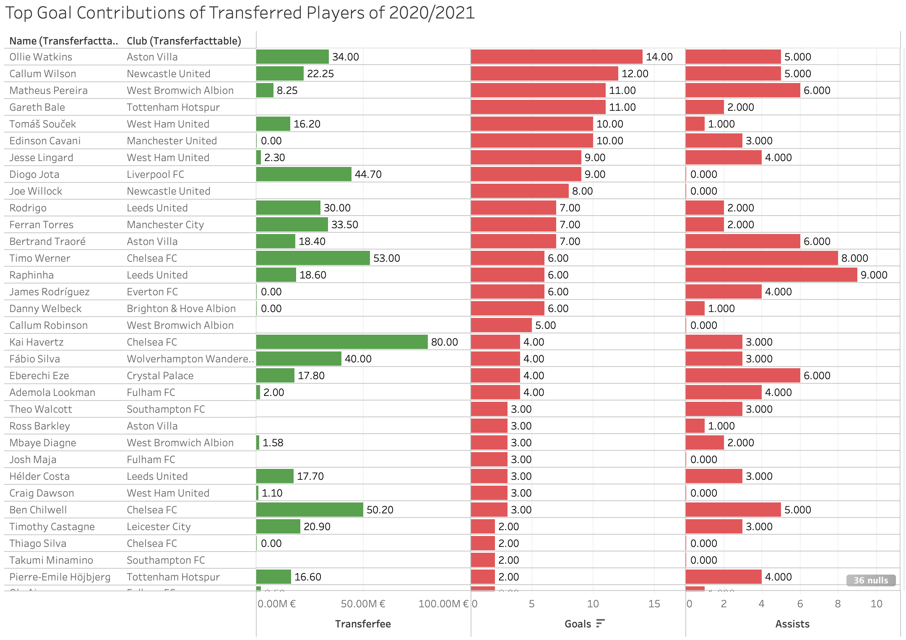
VISUALIZATION

Slide 20
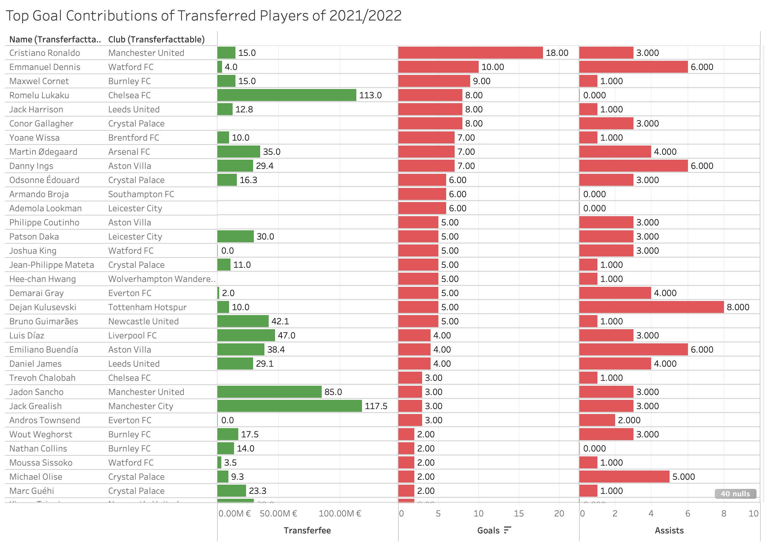
VISUALIZATION

Slide 21
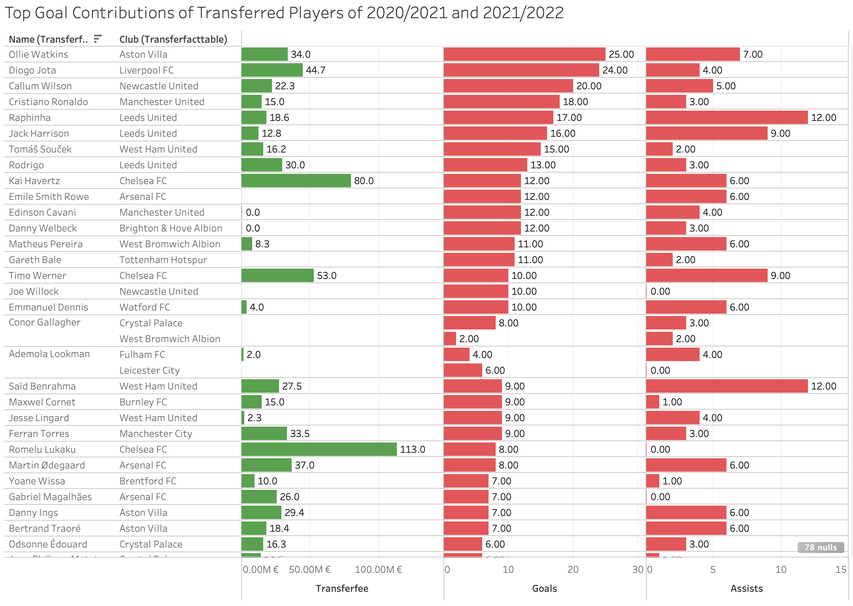
VISUALIZATION

Slide 22
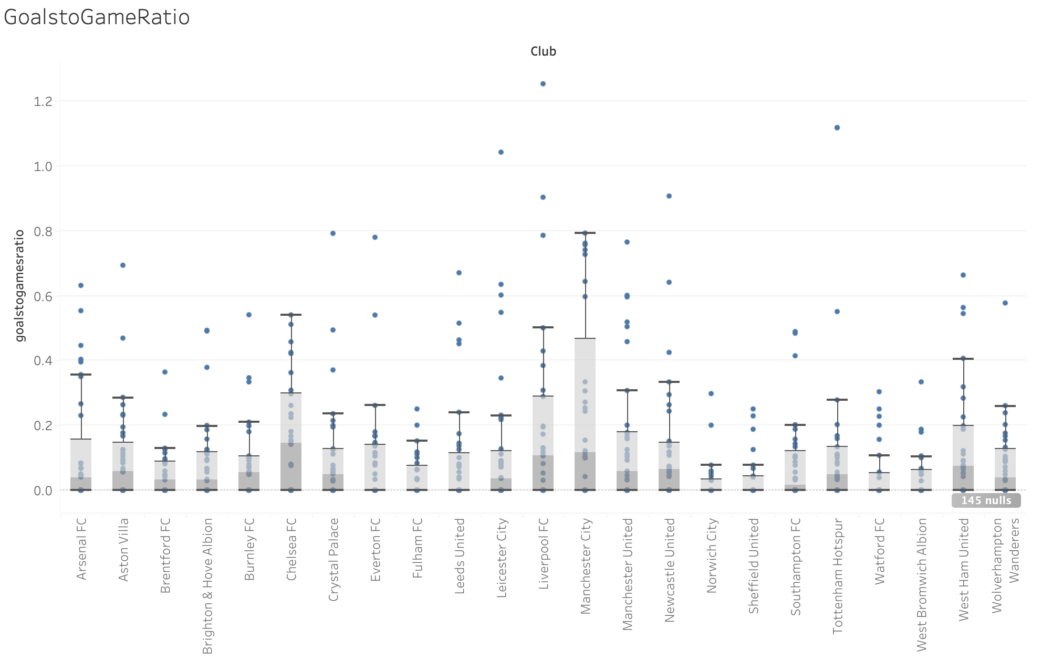
VISUALIZATION

Slide 23
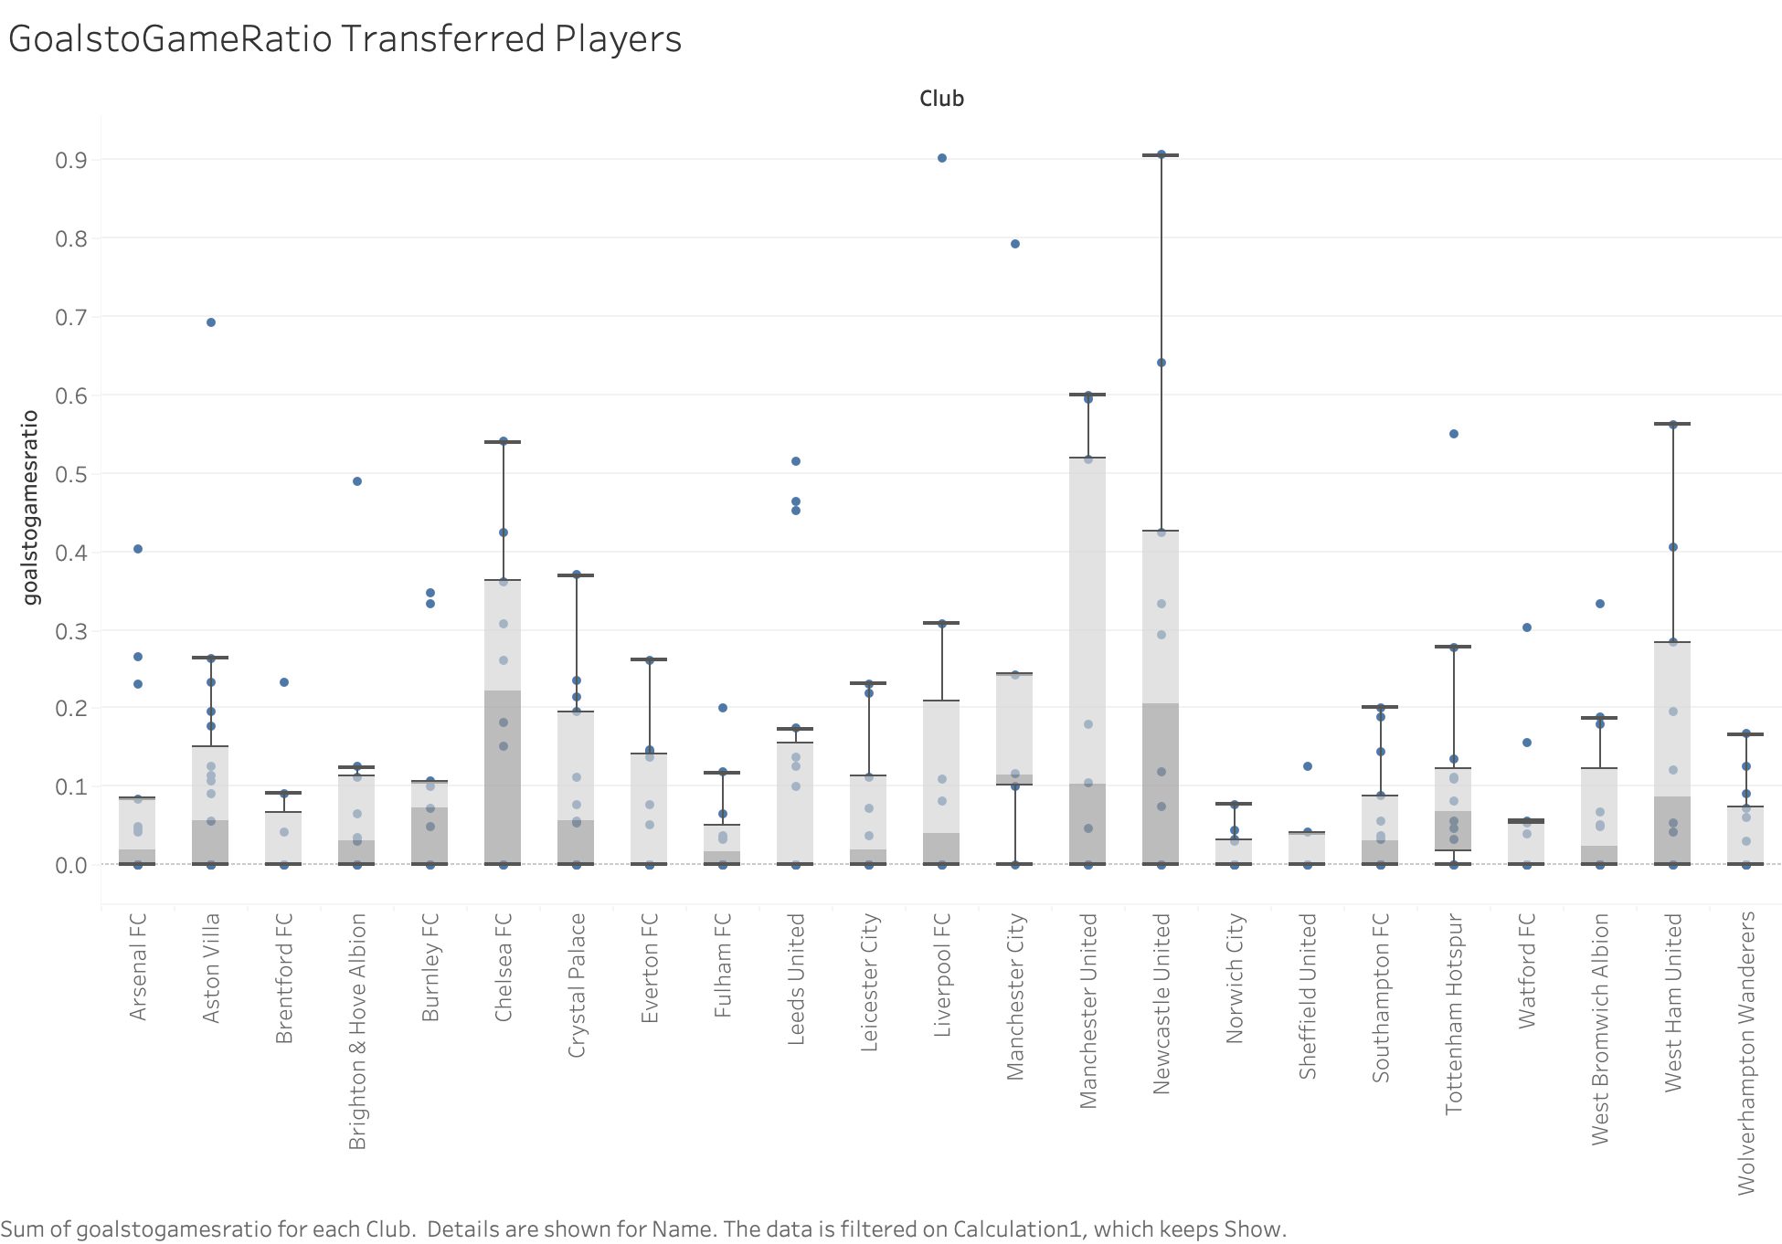
VISUALIZATION

Slide 24
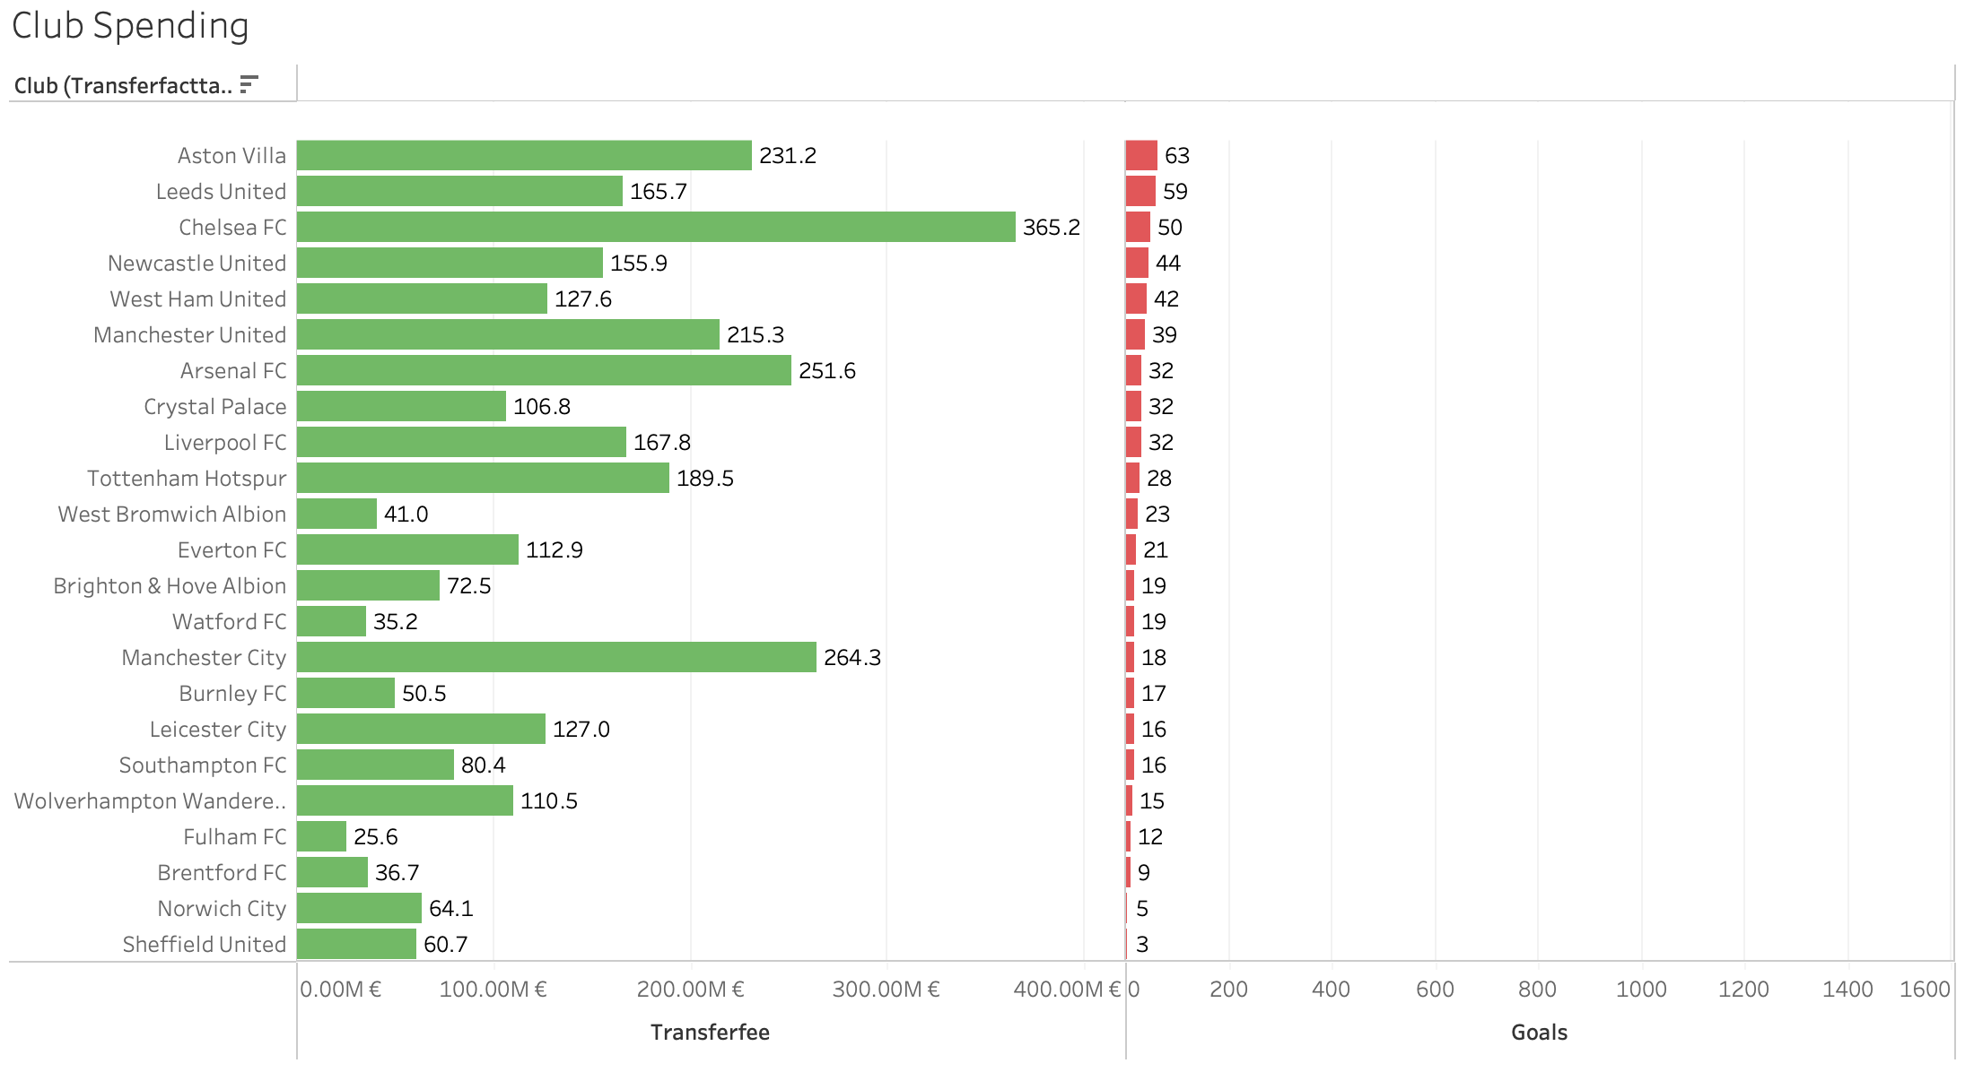
VISUALIZATION

